Slide 1

Question words in Muruwari
minjan?
why?
how?
what?
wandanj?
who?
which?
dirra?
ngaana?
when?
where?
Notes:
Just like in English there are question words that mean what, why, how, when, who which where and when. There are a few extra rules around how to use them in Muruwari.

Slide 2
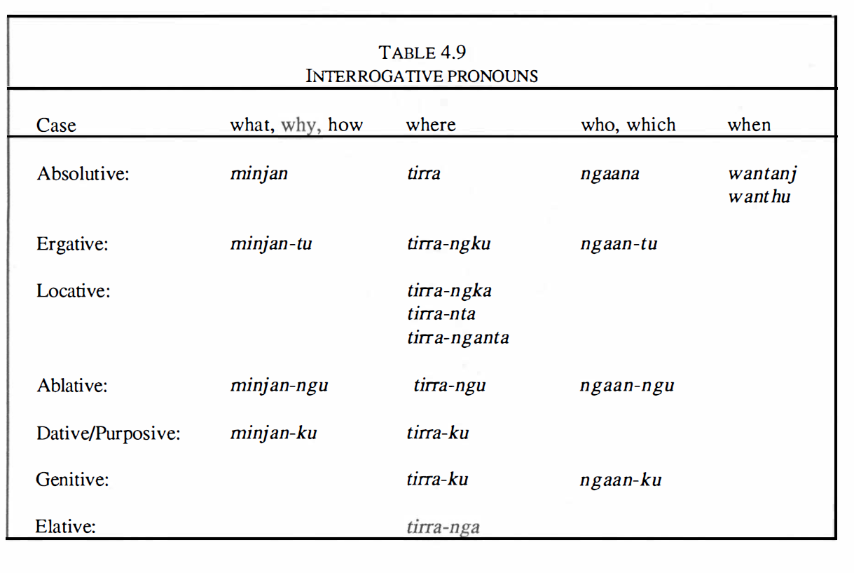
The Muruwari Language
Lynette Oates pacific linguistics Series C – No.108 Page 121
Notes:
In this 3rd lesson I will look at how to use what DIRRA = which
You may notice that dirra has by far the most extensive range of suffixes of all of the question words including 3 options for locatives.

Slide 3
LESSON 3
WHERE - dirra
REVISION of lesson 1 & 2
Notes:
Just as in lesson 1 - Question words will be broken up into individual bite-size lessons to make it easier. In lesson 3 I will cover DIRRA and its multiple meanings … And do some revision at the end.

Slide 4
Where (doer) = Dirra
Where (from) = Dirra-ngu
Where = dirra
Where to = Dirra-gu
Where(location)= Dirra-ngga (+ dirra-nda dirra-nganda)
Notes:
Now let’s look at the word for WHERE – in Muruwari it is dirra….
I have simplified the explanation of Dirra because the description by Lynette Oates seems incomplete.
(1) DIRRA which does NOT have a suffix is used in an intransitive sentence – a sentence with a DOER but no object (done-to) - as in where’s your spear?
(2) Dirra can take the suffix –NGU to mean WHERE FROM
(3) Dirra can take the suffix –GU to mean Where to..
(4) Finally– and probably most obviously – DIRRA can take a locative suffix. In Lynette Oates description of the Muruwari language she in fact references 3 different types of locative suffixes but only theorises as to why there are 3, perhaps in reference to distance. For ease of learning I will only reference the usual locative – ngga. It also seems that you can leave off the –ngka suffix and it will not change the meaning.

Slide 5
* NOTE
Intransitive sentence
No suffix needed
Where is your spear?
Dirra guliya baga?
Where spear your?
Here is your spear
Nhuu guliya baga
Notes:
In the simple intransitive sentence – where is your spear? Spear subject
READ slide
Explain possessive 2nd person
The answer to the question – here is your spear – is written below. Notice that spear is still in green – meaning it’s intransitive and that ‘here’ – ‘nhuu’ needs no suffix.

Slide 6
* NOTE
What FROM (ablative)
–ngu suffix needed
Where do you come from?
Dirra-ngu balga-ndu
Where-from come-you
You come from there
balga-ndu nhurra-ngu
Notes:
Let’s move to the next suffix which means FROM in Muruwari – ngu
Remember the suffix –ngu meaning FROM is A very common noun suffix.
The sentence ‘ where do you come from?’ - becomes in Muruwari - where-from, come you?
Dirra-ngu (where from) balga-ndu (come – verb bound with the personal pronoun –ndu you)
Re-Read sentence
Notice that in the answer to the question – You come from there – each of the words remain grammatically consistent – that is both where and there both need the ablative suffix –ngu to show that it means ‘from’ where from & from there.

Slide 7
* NOTE
Dative/ALLATIVE (to)
–gu suffix needed
Where’s he running to?
Dirra-gu dhanggi-bu?
Where-to running-he ?
He is running to there
dhanggi-ndu nhurra-gu
Notes:
The last suffix that we will look at is the suffix –gu.
Remember that -gu is a the most common of all the suffixes because it can mean many things. You would understand which –gu was being used because of the context in which you speaking. In this sentence –gu means for the purpose of or purposive.
In the sentence Where’s he running to? Dirra-gu dhanggi-bu - DIRRA (where) needs the suffix –gu to mean To (to where or where to)?
The personal pronoun ‘he’ in green is attached or BOUND to the verb running - it is in green because it is the subject in an intransitive sentence.
Again notice that in the answer to the question – He is running to there – each of the words remain grammatically consistent – that is both where and there both need the allative suffix - gu to show that it means ‘to’ where (or where to) & to there (or there to).

Slide 8
Some revision about questions in Muruwari
Notes:
Read screen

Slide 9

Warri…. doubt
You can add the common, stand alone word ‘warri’ to your sentence - to mean ‘don’t know’ ‘maybe’ ‘might’
‘warri’ adds DOUBT…
Warri usually comes before the verb and after the question
Notes:
Read screen

Slide 10
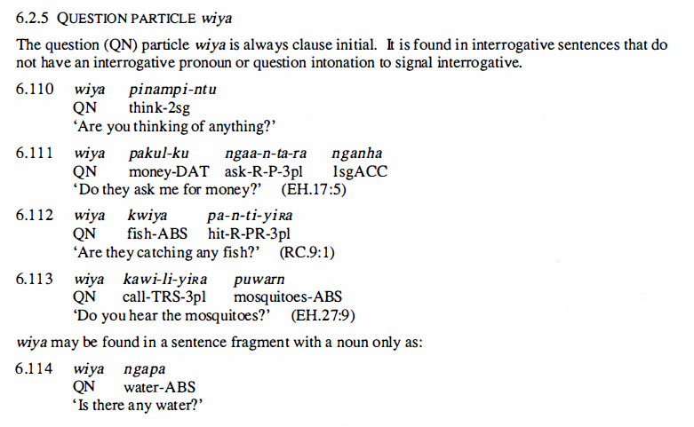
Wiya…. It’s a question
You can indicate to the speaker clearly that you are asking a question by putting ‘wiya’ at the beginning without needing to use any of the specific question words. Here are 5 examples from Lynette Oates’ description of Muruwari language 1988 page 209.
Notes:
Wiya is a common and really useful word it means – I’m asking a question. Read screen

Slide 11
Revision
when = wandanj - 1 form
who/which = ngaana - 4 forms
warri = doubt
wiya = it’s a question
What = Minjan - 4 forms
Where = dirra – 4 possible forms
Notes:
Let’s do a quick revision
When is the simplest of the Muruwari question words because it only has 1 form – wandanj
Who and which NGAANA has 4 forms – can you remember them? (1) unmarked for intransitive, (2) marked –du for the transitive or doer-to (3) From is marked by the suffix –ngu and (4) ownership like all nouns is marked with the very common suffix –gu
Warri indicates doubt
Wiya indicates that you are asking a question.
Minjan means what (& sometimes why and how) and it has 4 forms
WHERE – DIRRA can be (1) unmarked for intransitive, (2) marked by the suffix –ngu to mean From and (3) marked with the very common suffix –gu to mean where to lastly you can choose to mark Dirra with the locative suffix-nggu but to show its about location, but it is not necessary and can be left off.

