Slide 1

Question words in Muruwari
minjan?
why?
how?
what?
wandanj?
who?
which?
dirra?
ngaana?
when?
where?
Notes:
Just like in English there are question words that mean what, why, how, when, who which where and when. There are a few extra rules around how to use them in Muruwari.

Slide 2
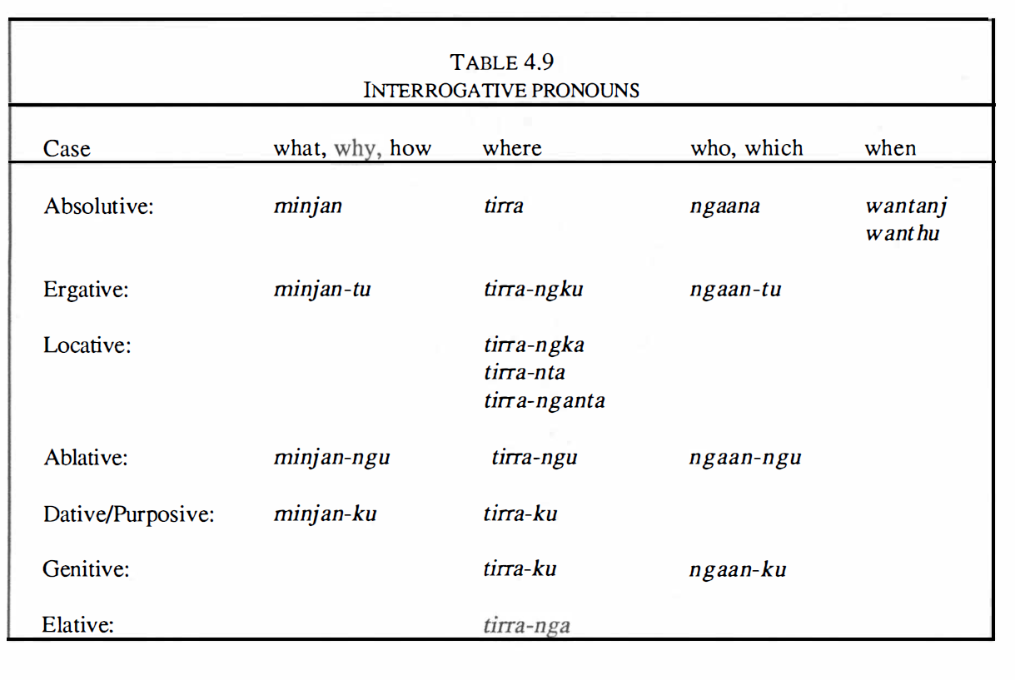
The Muruwari Language
Lynette Oates pacific linguistics Series C – No.108 Page 121
Notes:
The table 4.9 on this page – is taken form The Muruwari language description by Lynette Oates Page 121. It outlines the interrogative pronouns and how the suffixes change to shift meaning. In this 2nd lesson I will look at how to use what MINJAN (which can also mean why & how)
Remember that we have chosen in all of our work on our website in Muruwari to replace the k’s for g’s the t’s for d’s and the p’s for b’s so don’t be confused in reading the table.

Slide 3
LESSON 2
WHAT (HOW / WHY) - minjan
REVISION of lesson 1
Notes:
Just as in lesson 1 - Question words will be broken up into individual bite-size lessons to make it easier. In lesson 2 will cover MINJAN and its 4 different meanings … And do some revision at the end.

Slide 4
Word order for question words
(or interrogatives)
The question words usually come first in a sentence but can also come at the end for emphasis.
Notes:
Read screen

Slide 5
What (doer) = Minjan
What (doer-to) = Minjan-du
What = minjan
What (from) = Minjan-ngu
What for (purpose/benefit) = Minjan-gu
Notes:
Now let’s look at the word for WHAT (tha can also mean why and how) – in Muruwari it is minjan…. Remember in Muruwari you can add suffixes to shift the meaning so that there are in fact 4 words:
MINJAN which does NOT have a suffix and is used in an intransitive sentence – that is a sentence with a DOER but no object (done-to) - as what’s your name?
Whilst Lynette Oats does reference MINJAN-DU meaning that the “WHAT” is the doer-to (or ergative), the information around this use is extremely limited so I have chosen to leave it out of this explanation lesson.
it can take the suffix –NGU to mean FROM (what from) and finally
it can take the suffix –GU to mean what FOR?
You might notice that unlike ngaana (who) in lesson 1 – there is no possessive or genitive suffix that can be used on minjan!
Throughout the video lessons to ensure consistency with the living languages documents & to avoid confusion I have kept the DOER-TO in red & the DONE-TO in blue and an intransitive subject in GREEN..

Slide 6
* NOTE
Intransitive sentence
No suffix needed
What’s your name?
Minjan gurri?
Notes:
The simplest sentence to learn is what’s you name – Minjan gurri. I have created a secondary resource called what’s your name and where do you live to help you practice remembering these key sentences.
Remember the question word needs to come first – minjan – it’s highlighted in yellow. As in lesson 1 - I have colour coded the sentence – green for subject in an intransitive sentence, grey for the noun phrase.
Notice that the subject (your) is simply understood in the Muruwari sentence, although you could if you wanted, say minjan gurri yingga – with the stand alone pronoun yingga meaning ‘yours’ you could, but Muruwari spoke in shorthand and minjan gurri is correct.
Notice also that it is verbless.

Slide 7
* NOTE
What FROM (ablative)
–ngu suffix needed
What from?
Minjan-ngu
What from/why what from/why you cry?
Minjan-ngu minjan-ngu wangi-yi-ndu?
What-from what-from cry-now-you?
Notes:
Let’s move to the next suffix which means FROM in Muruwari – ngu
Remember the suffix –ngu meaning FROM is a very common noun suffix. I have given 2 examples from Emily Horneville.
The simple sentence ‘ what from?’ in Muruwari is again a short-hand way of speaking and is verbless. Minjan-ngu?
The second sentence – what from or why are you crying has minjan-ngu repeated, probably for emphasis. Wangi means to cry wangi-yi-ndu is you crying now.
Read sentence

Slide 8
* NOTE
FOR (purpose or dative)
–gu suffix needed
What do you want to go for?
Minjan-gu yan-di-ndu?
What - for go-now-you ?
Notes:
The last suffix that we will look at is the suffix –gu.
Remember that -gu is a the most common of all the suffixes because it can mean many things, including indicating possession (or genitive), it can mean ‘for’, for the purpose of and for the beneficiary of (dative), it can also mean to, to a particular place or time. You would understand which –gu was being used because of the context in which you speaking. In this sentence –gu means for the purpose of or purposive.
In the sentence what do you want to go for? Minjan needs the suffix –gu to mean what for? For what purpose or reason do you want to go? You is in green because it is the subject in an intransitive sentence.
Minjan-gu yan-di-ndu
The suffix –di makes it present tense and the –ndu is the pronoun ‘you’ which is bound to the verb go – go now you… but more on verbs later

Slide 9
* NOTE
What FROM (ablative)
–ngu suffix needed
FOR (purpose or dative)
–gu suffix needed
What was up with him, why did he go?
Minjan-ngu Minjan-gu yan-da-a?
What-from what-for go-did(P)-he ?
Notes:
Here is a very interesting sentence spoken by Emily Horneville that has WHAT – minjan used 2 different ways within the one sentence.
What was up with him – why did he go?
Minjan-ngu (meaning what from) minjan-gu (meaning what for or purpose or why) yan-da-a (go did he).
You might notice the verb ‘ya’ or go – it has the suffix –da –a. The –da suffix changes the verb to past tense and matches the personal pronoun –a which is also in past tense. The extra –a suffix at the end of the verb means 3rd person singular. If this verb was in the present tense it would have the suffix –bu. I will cover verbs at a later stage as they are the most complex parts of the Muruwari grammar.

Slide 10
Some revision about questions in Muruwari
Notes:
Read screen

Slide 11

Warri…. doubt
You can add the common, stand alone word ‘warri’ to your sentence - to mean ‘don’t know’ ‘maybe’ ‘might’
‘warri’ adds DOUBT…
Warri usually comes before the verb and after the question
Notes:
Read screen

Slide 12
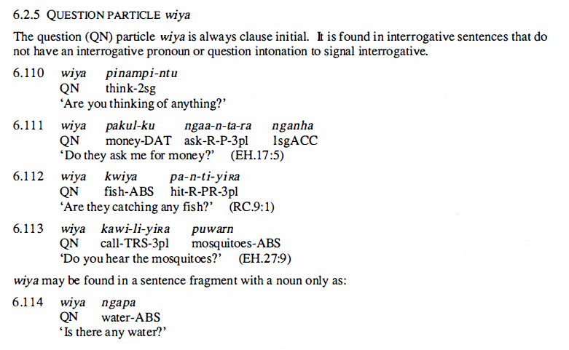
Wiya…. It’s a question
You can indicate to the speaker clearly that you are asking a question by putting ‘wiya’ at the beginning without needing to use any of the specific question words. Here are 5 examples from Lynette Oates’ description of Muruwari language 1988 page 209.
Notes:
Wiya is a common and really useful word it means – I’m asking a question. Read screen

Slide 13
Revision
when = wandanj - 1 form
who/which = ngaana - 4 forms
warri = doubt
wiya = it’s a question
What = Minjan - 4 forms
Notes:
Let’s do a quick revision
When is the simplest of the Muruwari question words because it only has 1 form – wandanj
Who and which NGAANA has 4 forms – can you remember them? (1) unmarked for intransitive, (2) marked –du for the transitive or doer-to (3) From is marked by the suffix –ngu and (4) ownership like all nouns is marked with the very common suffix –gu
Warri indicates doubt
Wiya indicates that you are asking a question.
Minjan means what (& sometimes why and how) and it has 4 forms
The final lesson on question words will be on understanding how to use the word WHERE – dirra.

