Slide 1

Question words in Muruwari
minjan?
why?
how?
what?
wandanj?
who?
which?
dirra?
ngaana?
when?
where?
Notes:
Just like in English there are question words that mean what, why, how, when, who which where and when. There are a few extra rules around how to use them in Muruwari.

Slide 2
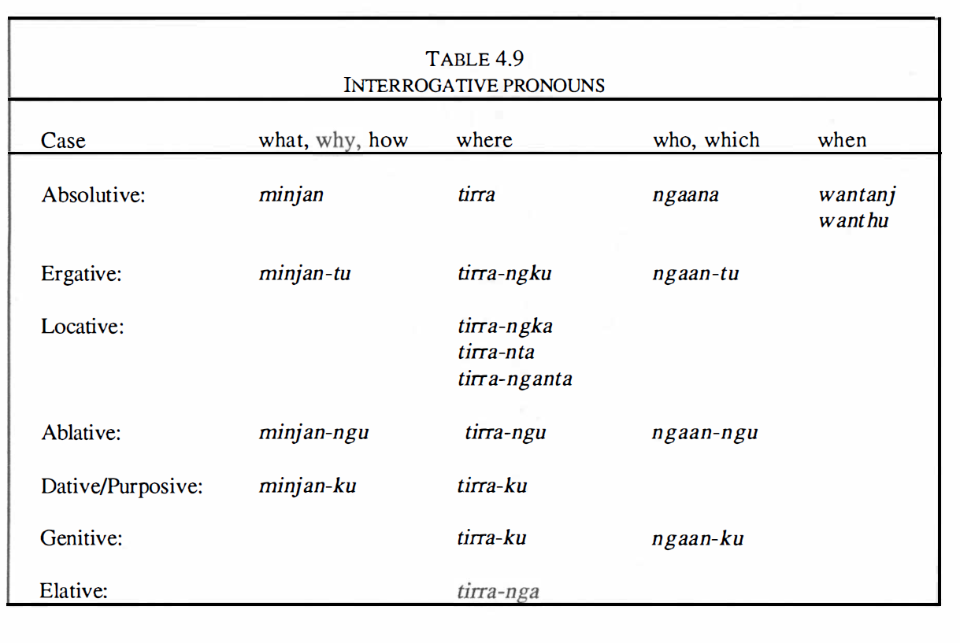
The Muruwari Language
Lynette Oates pacific linguistics Series C – No.108 Page 121
Notes:
The table 4.9 on this page – is taken form The Muruwari language description by Lynette Oates Page 121. It outlines the interrogative pronouns and how the suffixes change to shift meaning. In this lesson I will do an introduction and look at how to use when and who/which.
Remember that we have chosen in all of our work in Muruwari to replace the k’s for g’s the t’s for d’s and the p’s for b’s so don’t be confused in reading the table.

Slide 3
LESSON 1
WHEN - wandanj
WHO / WHICH - ngaana
DOUBT - warri
‘ It’s a question’ - wiya
Notes:
Question words will be broken up into individual bite-size lessons to make it easier. In lesson 1 we will cover when wandanj the variations of who/which = ngaana doubt = warri and it’s a question - wiya

Slide 4
Word order for question words
(or interrogatives)
The question words usually come first in a sentence but can also come at the end for emphasis.
Notes:
Read screen

Slide 5
Girl going-now-she river-to
* NOTE
-mi
Suffix means progressive forward movement. In English it would be the difference between go & going
The girl is going to the river
Guni yan-mi-bu ngarndu-gu
Girl Go -PROG -3rd Singular river-to
Notes:
Let’s take a simple intransitive statement (that means there is a subject (girl), a verb (is going) and no direct object. The girl is going to the river – in Muruwari you would say – guni yanmibu ngarndu-gu
Remember that suffixes in Muruwari hold all of that extra information - for example – you can have suffixes for tense and personal pronouns on a verb and location on a noun.

Slide 6
when = wandanj
Notes:
But what if you wanted to know when. The word for WHEN in Muruwari is WANDANJ. Wandanj is the simplest of the Muruwari question words as it has no Suffixes – it is always just wandanj

Slide 7
When is the girl going to the river?
Wandanj guni yan-di-bu ngarndu-gu?
When girl going –fact- she river- to
When girl going river-to?
Notes:
READ script… out of all the questions WHEN is the simplest in Muruwari to remember because it doesn’t ever change. Explain FACTIVE + –gu meaning ‘towards’

Slide 8
Who = Ngaana
Who (doer) = Ngaana
Who (doer-to) = Ngaan-du
Which = Ngaana
Who (from) = Ngaan-ngu
Whose (ownership) = Ngaan-gu
Notes:
Now let’s look at the word for WHO/WHICH – in Muruwari it is ngaana…. In English we have 2 words – who and which – but in Muruwari you can add suffixes to shift the meaning so that there are in fact 4 words: (1) NGAANA which does NOT have a suffix and is used in an intransitive sentence – that is a sentence with a DOER but no object (done-to) (2) second it can take the suffix –du = NGAAN-DU meaning that the “WHO” is the doer-to, there is something or one who is affected by the action (3) it can take the suffix –NGU to mean FROM (who from – as in the sentence where are you from?) and finally (4) it can take the suffix –GU to show ownership or possession (as in whose dog is it?). Throughout the video lessons to ensure consistency with the living languages documents & to avoid confusion I have kept the DOER-TO in red & the DONE-TO in blue and an intransitive subject in GREEN..

Slide 9
Girl going-now river-to subject verb extra information (location)
* NOTE
Intransitive sentence
No suffix needed
Who is going to the river?
Ngaana yan-mi ngarndu-gu
Notes:
If we wanted to ask who is going to the river – we would ask Ngaana yan-mi ngarndu-gu. Remember the question word needs to come first – ngaana – it’s highlighted in yellow. Notice that I have colour coded the sentence – green for subject in an intransitive sentence, grey for the noun phrase including the extra information of location. I have done this purposely to track that the correct form of ngaana is used. The subject GIRL is intransitive (in green) so the corresponding Muruwari subject (who) must also be green – and therefore doesn’t need a suffix. Let’s now look at sentences which need suffixes.

Slide 10
The girl ate the meat
* NOTE
Transitive sentence
-du suffix needed
Guni-ngga widji dhaa -ra - a
Who ate the meat?
Ngaan-du widji dhaa-ra-a
Who-(doer-to) meat eat -COMPLETE -3rd - she
Notes:
Let’s take the transitive sentence the girl ate the meat.
In Muruwari it becomes guni-ngga widji dhaa-ra-a (girl meat ate-she)
We want to form the question Who ate the meat?
The girl in the sentence is the doer-to (she affected the meat – she ate it) (so it’s in red) and therefore needs a doer-to or ergative suffix, therefore who (ngaan) also needs to be in red (it is doer-to). It also needs to be marked with a suffix to show that the who in the sentence is affecting the verb
The correct suffix is –du.
Ngaan-du widji dhaa-ra-a
You may have noticed the verb (in black) - The verb eat also has suffixes to show completion (past tense she ate it) but more on that at a later stage…

Slide 11
* NOTE
Where-from (ablative)
–ngu suffix needed
Where are you from?
Ngaan-ngu yindu
Who-from you - 2sg
Notes:
Let’s move to the next suffix which means FROM in Muruwari – ngu
The suffix –ngu meaning FROM in Muruwari is an extremely common noun suffix.
The simple sentence ‘ where are you from?’ in Muruwari becomes who from you. Notice the where in English shifts to who in Muruwari because it is in reference to a person- yindu.
Ngaan-ngu yindu.
Yindu means YOU, it is in green because it is the subject in an intransitive sentence.

Slide 12
* NOTE
Whose (genitive)
–gu suffix needed
Whose dog is it?
Ngaan-gu gundarl buga
Who-GEN dog his/hers/its-3GEN
Notes:
The last suffix that we will look at is the suffix that shows ownership –gu.
-gu is a the most common of all the suffixes because it can mean many things, including indicating possession (or genitive), it can mean ‘for’, for the purpose of and for the beneficiary of (dative), it can also mean to, to a particular place or time. You would understand which –gu was being used because of the context in which you speaking.
In the sentence whose dog is it, ngaana becomes ngaan-gu. Ngaan-gu gundarl buga. Gundarl is in green because it is the subject in an intransitive sentence. The personal pronoun buga means (his, hers or its) also reflects ownership. I will be doing a lesson on how pronouns shift later in this series.

Slide 13
Some extra information about questions in Muruwari
Notes:
Read screen

Slide 14

Warri…. doubt
You can add the common, stand alone word ‘warri’ to your sentence - to mean ‘don’t know’ ‘maybe’ ‘might’
‘warri’ adds DOUBT…
Warri usually comes before the verb and after the question
Notes:
Read screen

Slide 15
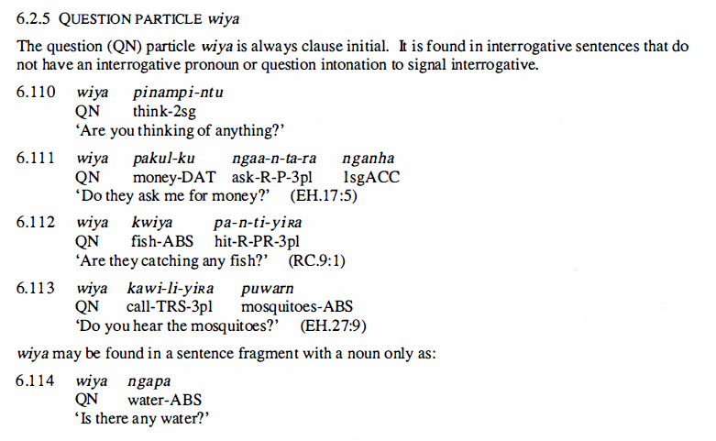
Wiya…. It’s a question
You can indicate to the speaker clearly that you are asking a question by putting ‘wiya’ at the beginning without needing to use any of the specific question words. Here are 5 examples from Lynette Oates’ description of Muruwari language 1988 page 209.
Notes:
Wiya is a common and really useful word it means – I’m asking a question. Read screen

Slide 16
Revision
when = wandanj- 1 form
who/which = ngaana- 4 forms
warri = doubt
wiya = it’s a question
Notes:
Let’s do a quick revision
When is the simplest of the Muruwari question words because it only has 1 form – wandanj
Who and which NGAANA has 4 forms – can you remember them? (1) unmarked for intransitive, (2) marked –du for the transitive or doer-to (3) From is marked by the suffix –ngu and (4) ownership like all nouns is marked with the very common suffix –gu
Warri indicates doubt
Wiya indicates that you are asking a question.
The next two lessons in the series on question words will be about how to use - where and what

